Slide 1
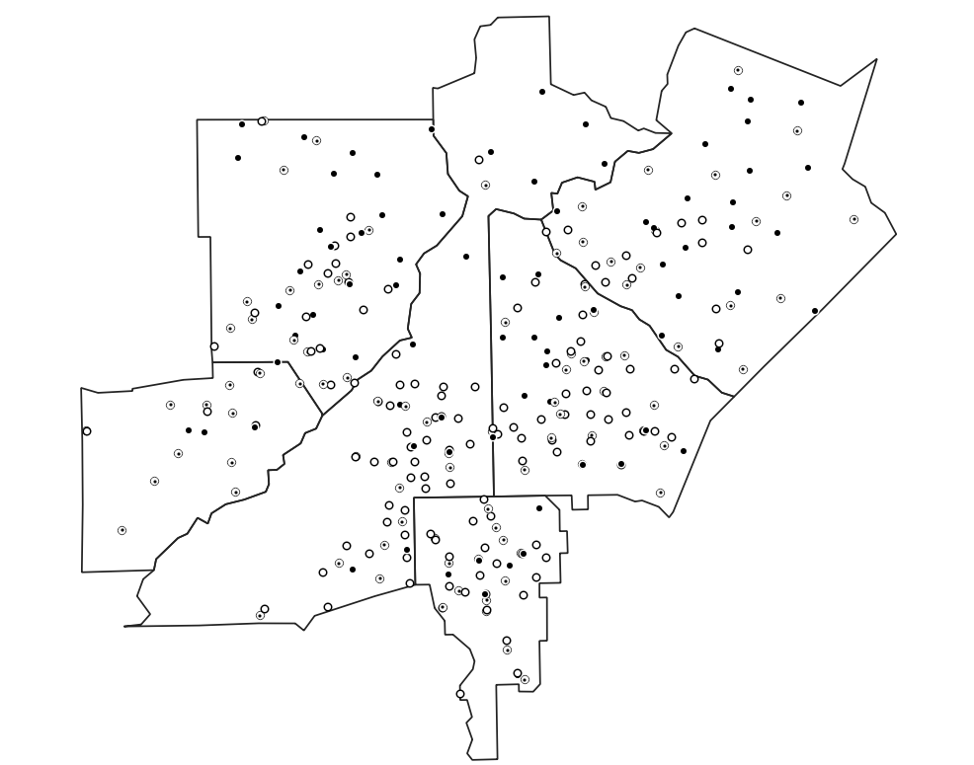
Week 5: Spatial data; Point pattern analysis
Geog4300: Harper

Slide 2
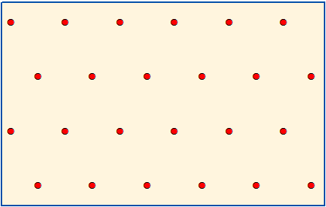
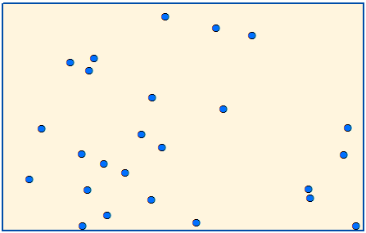
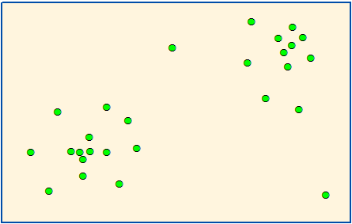
Point pattern analysis
How do we identify patterns in the distribution of point data?
Clustering and dispersion of point data
Distribution of point incidents (disease, natural disasters, species, crime, etc.)
Relative frequency of subevents (strong tornadoes, particular disease variants, etc.)
Notes:
Locational vs attributes.

Slide 3

Nearest Neighbor Index
$$\frac{Actual average distance}{Distance for random distribution}$$
Notes:
How clustered are the points?
If this is >1 what does it tell you?
Actual average distance > random → spread out.
If <1 → closer together.
Turn to neighbor and discuss which is which?
Blue: Random
Red: Dispersed – like magnets pushing each other apart.
Green: Clustered
This is a global measure – it’s describing the whole data set, not individual points.

Slide 4
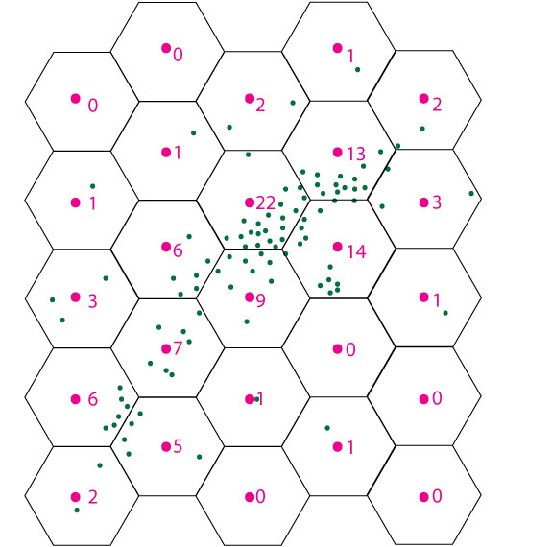
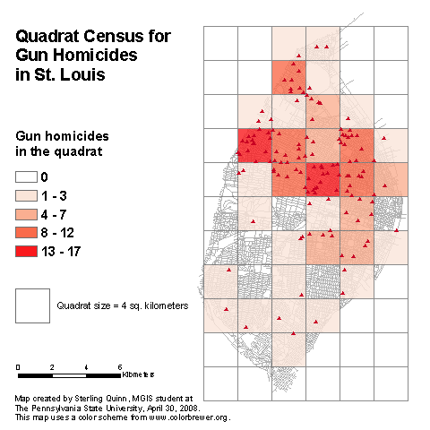
Quadrats
Aggregating points to a tessalated grid, usually squares or hexagons
Notes:
Quadrats:
Looks a little like raster.
Tessalation = ? A shape that’s repeated over and over.
Aggregate points into a grid. Enables quantification of the distribution of the data points.

Slide 5
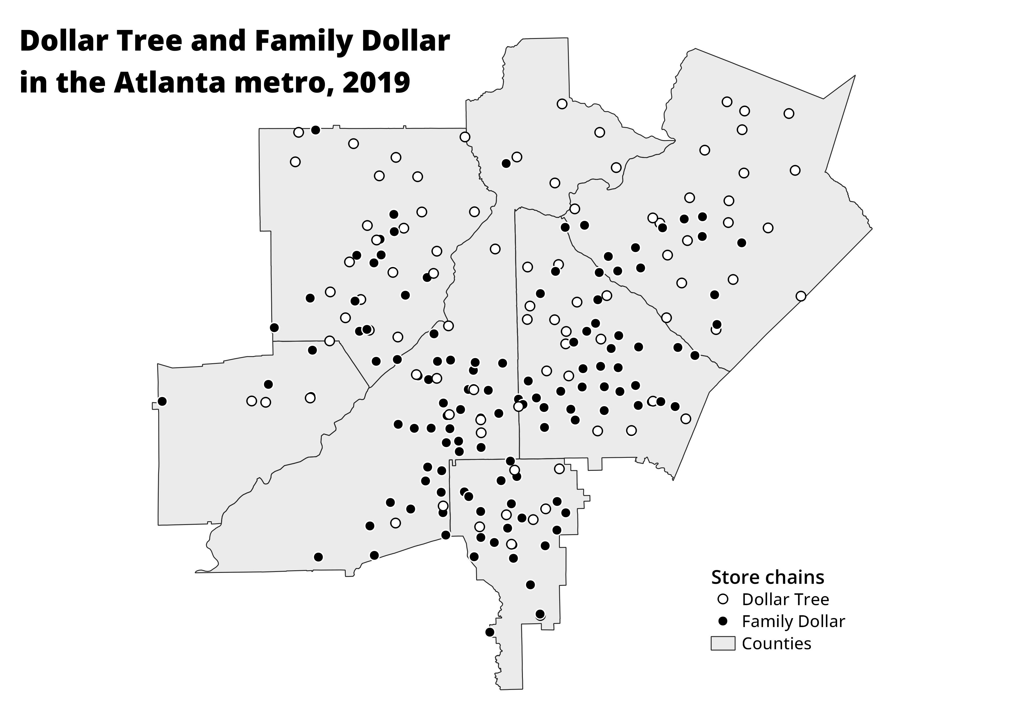
Let’s try it!
Dollar stores in Atlanta
Create a quadrat grid of 1.5 or 3 inch squares
Count the total stores for each chain in each grid cell
Notes:
Work sheets and rulers:
Dollar stores in Atlanta.
Make a grid. Count the stores in each grid cell.
Make a table with cell index, FD, DT, total

Slide 6

Location quotient
Relative incidence of a particular event
Pick a chain and count just those points
What is the percentage of all stores for each grid cell?
$$LQ=\frac{{pct}_{subarea}}{{pct}_{area}}$$
For the whole area:
Dollar General: 31% (93/305)
Dollar Tree: 28% (86/305)
Family Dollar: 41% (126/305)
Notes:
Rate in a sub-area compared to rate in a whole area.
e.g. how many tornadoes in Minnesota compared to entire Midwest? (30% in Minn vs 20% in Midwest).
When is this useful?
It’s a form of hotspot analysis – when is something happening more often in a certain area.
Severe vs mild disease maps.
% of trees with an insect infection in a subarea compared to larger region.
e.g. 41% of stores are FD, but in each grid you’ve just created the % will be different.
LQ < 1 means the rate is lower than the region average.
LQ > 1 means the rate is higher than the region average.

Slide 7
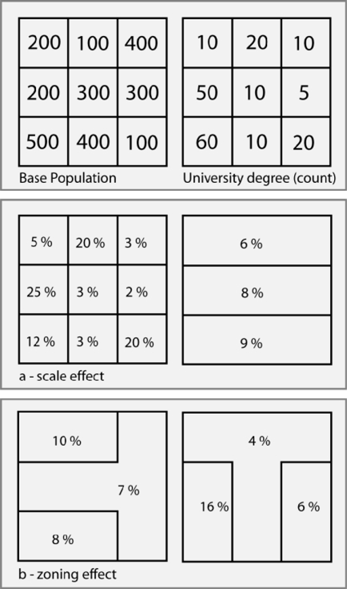
The Modifiable Areal Unit Problem
How did our quadrat maps vary?
Notes:
MAUP:
Gerry-mandering – you change the boundaries and get different results!
Where are the hotspots for atl metro area? People might get slightly different answers because of MAUP.

Slide 8
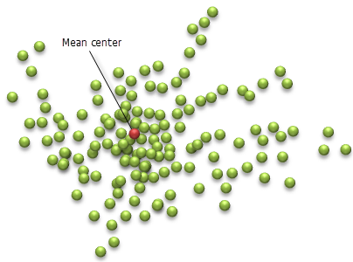
Mean center
What is the average X/Y coordinate of each point?
Open the dollarstores_atlcore CSV file in Excel/Sheets (file is in the repo)
What’s the mean X and Y coordinate for each store chain?
Where are each of those points located?
What does this mean?

Slide 10
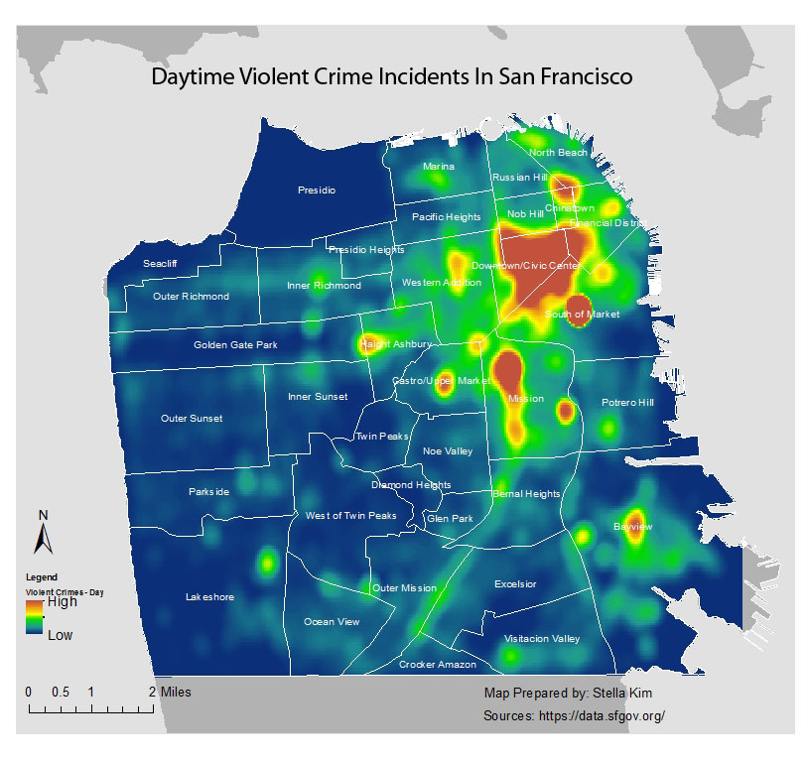
Kernel density estimation

Slide 11
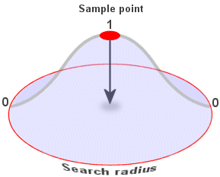
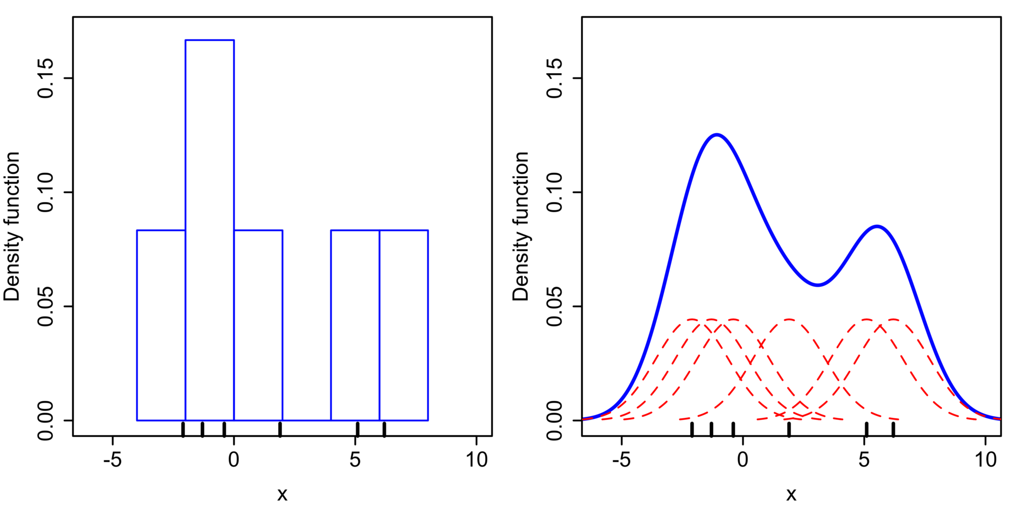
Kernel density estimation

Slide 12

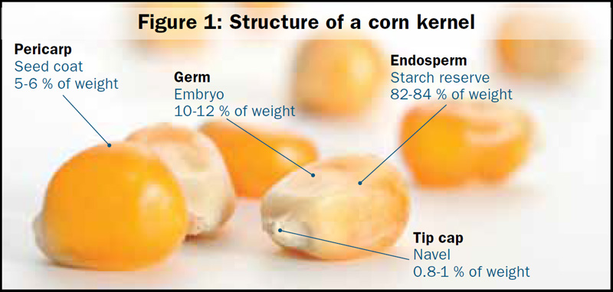
Problems with kernel density estimation
Fuzzy estimates rather than precise points
Influential outliers

Slide 13
Lab 2
Mapping reported crime in Spokane, WA
Mean centers by type of offense
Calculating crime rates by precinct
Calculating the LQ for burglaries
Bonus: Creating a quadrat map

